Slide 1
Physics Department, Bingham University PHY 101 Lectures by Mrs. O. V. Oyelade Part B: Introductory Classical Mechanics
Course content
Work and Energy
Rotational Motion
Bodies in Equilibrium
Newton’s Universal Gravitation
Oscillatory Motion

Slide 2
OSCILLATORY MOTION

Slide 3
Oscillatory Motion
Periodic motion
Spring-mass system
Differential equation of motion
Simple Harmonic Motion (SHM)
Energy of SHM
Pendulum

Slide 4
Periodic Motion
Periodic motion is a motion that regularly returns to a given position after a fixed time interval.
A particular type of periodic motion is “simple harmonic motion,” which arises when the force acting on an object is proportional to the position of the object about some equilibrium position.
The motion of an object connected to a spring is a good example.

Slide 5
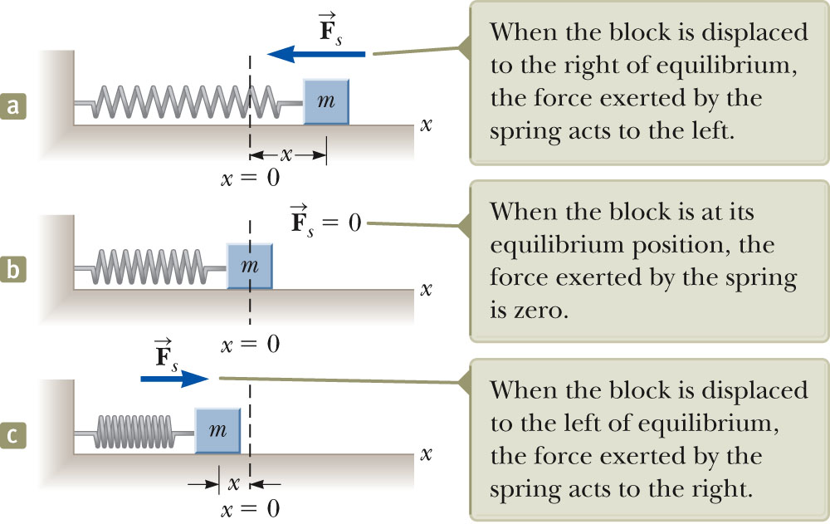
Periodic Motion

Slide 6
Restoring Force and the Spring Mass System
The force exerted by the spring depends on the displacement
Hooke’s Law states F_{s} = -kx
F_{s} is the restoring force.
It is always directed toward the equilibrium position.
Therefore, it is always opposite the displacement from equilibrium.
k is the force (spring) constant.
x is the displacement.

Slide 7
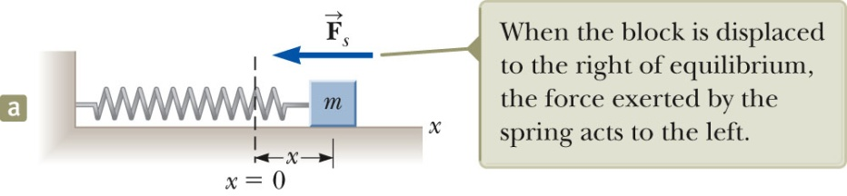
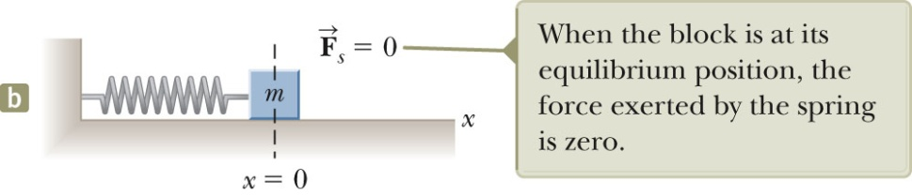
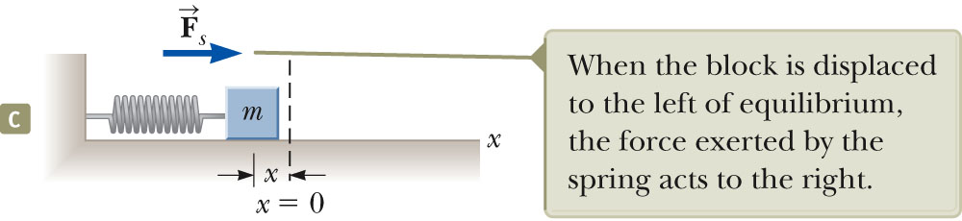
Restoring Force and the Spring Mass System
In (a) the block is displaced to the right of x = 0.
The position is positive.
The restoring force is directed to
the left (negative).
In (b) the block is at the equilibrium position.
x = 0
The spring is neither stretched nor compressed.
The force is 0.
In (c) the block is displaced to the left of x = 0.
The position is negative.
The restoring force is directed to
the right (positive).

Slide 8
Differential Equation of Motion
Using F = ma for the spring, we have
But recall that acceleration is the second derivative of the position:
So this simple force equation is an example of a differential equation,
An object moves in Simple Harmonic Motion (SHM) whenever its acceleration is proportional to its position and has the opposite sign to the displacement from equilibrium.

Slide 9
Acceleration
The force is not constant, so the acceleration is not constant either.
Note that the acceleration is NOT constant, unlike the other kinematic equations.
If the block is released from some position x = A, then the initial acceleration is – kA/m, but as it passes through 0 the acceleration falls to zero.
It only continues past its equilibrium point because it now has momentum (and kinetic energy) that carries it on past x = 0.
The block continues to x = – A, where its acceleration then becomes +kA/m.

Slide 10
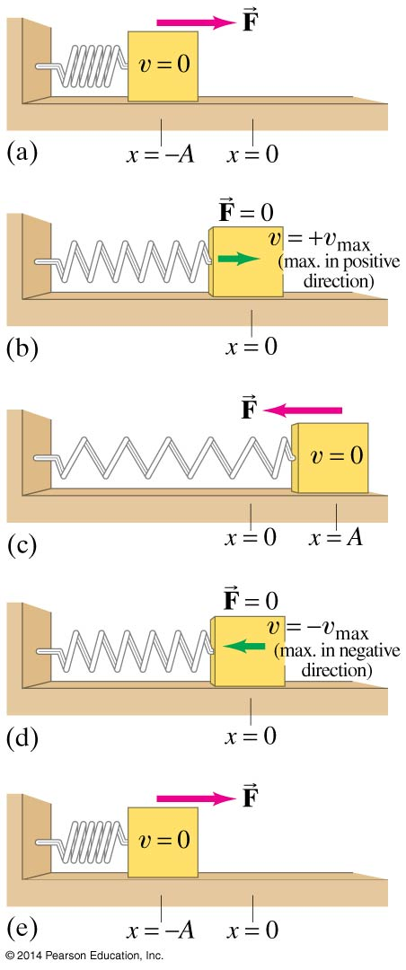
Terms in oscillatory motion
Displacement is measured from the equilibrium point
Amplitude is the maximum displacement
A cycle is a full to-and-fro motion; this figure shows half a cycle
Period is the time required to complete one cycle
Frequency is the number of cycles completed per second

Slide 11

Simple Harmonic Motion
but
Then the equation becomes
A typical way to solve such a differential equation is to simply search for a function that satisfies the requirement, in this case, that its second derivative yields the negative of itself! The sine and cosine functions meet these requirements.

Slide 12
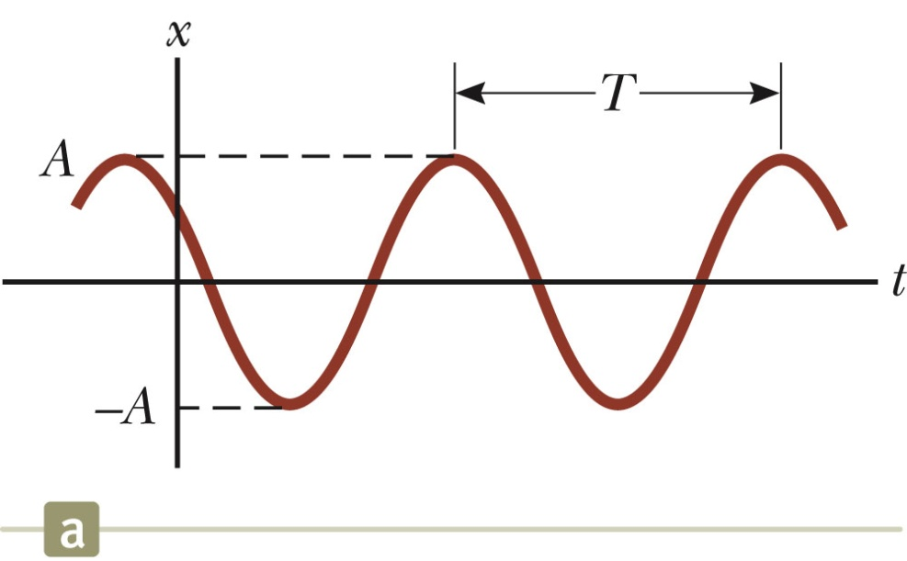
SHM Graphical Representation
A solution to the differential
equation is
A, ω, φ are all constants:
A = amplitude (maximum position
in either positive or negative x direction,
ω = angular frequency, Note
φ = phase constant, or initial phase angle.
A and φ are determined by initial conditions.

Slide 13
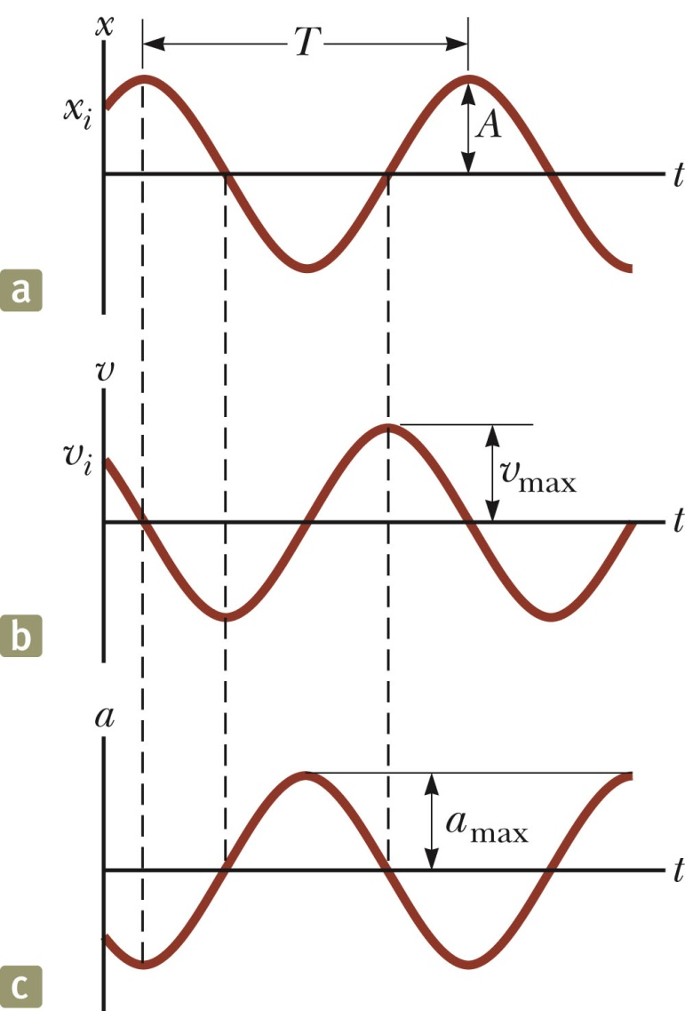
Motion Equations for SHM
The velocity is 90º out of phase
with the displacement and the
acceleration is 180º out of phase
with the displacement.

Slide 14
Motion Equations for SHM
We can similarly find the position as a function of time:

Slide 15
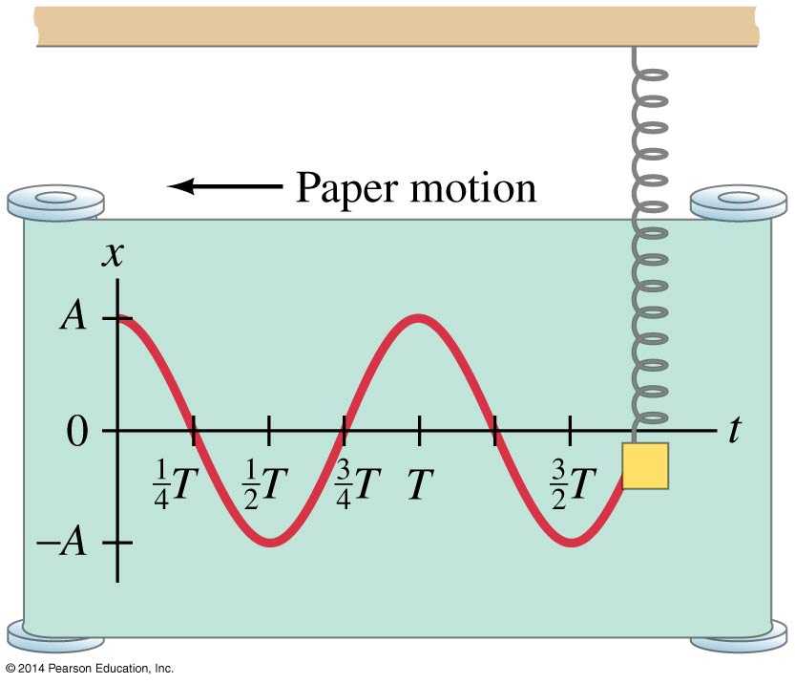
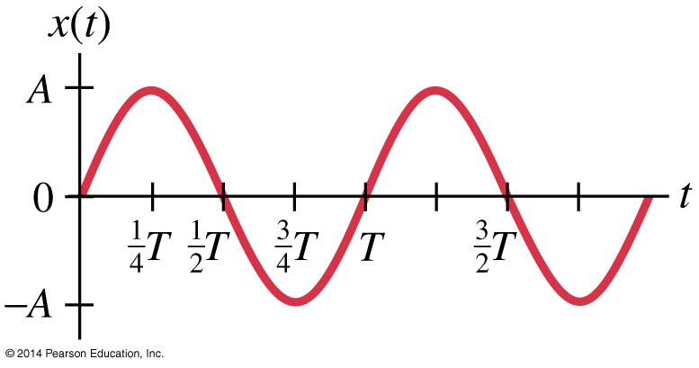
Motion Equations for SHM
This curve is a graph of the previous equation.
This curve is the same the one above it, but shifted ¼ period so that it is a sine function rather than a cosine.

Slide 16
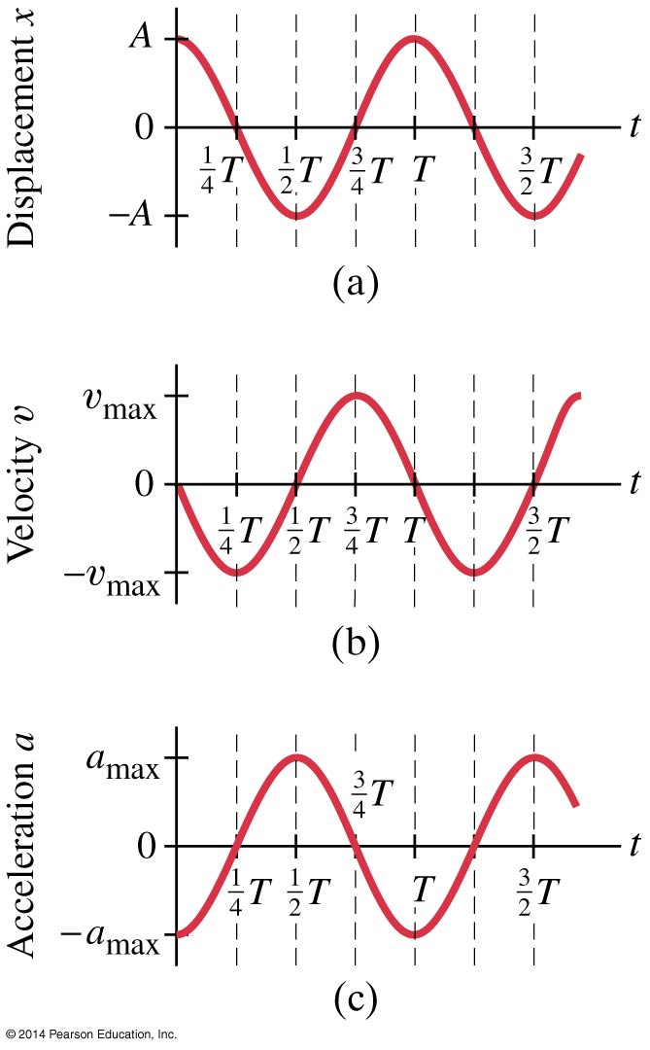





The Period and Sinusoidal Nature of SHM
The velocity and acceleration can be calculated as functions of time; the results are below, and are plotted at right.

Slide 17
Energy of SHM Oscillator
The spring force is a conservative force, so in a frictionless system the energy is constant
Kinetic energy, as usual, is
The spring potential energy, as usual, is
Then the total energy is just

Slide 18
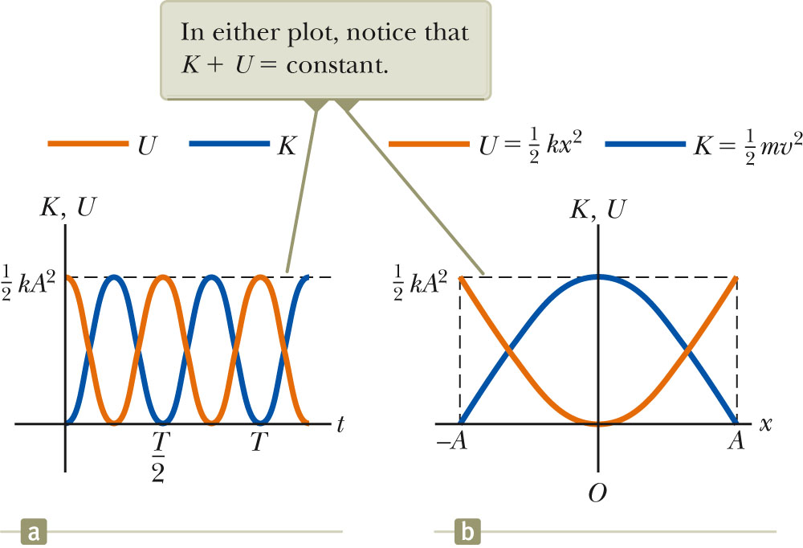
Transfer of Energy of SHM
The total energy is constant at all times, and is (proportional to the square of the amplitude)
Energy is continuously being transferred between potential energy stored in the spring, and the kinetic energy of the block.

Slide 19
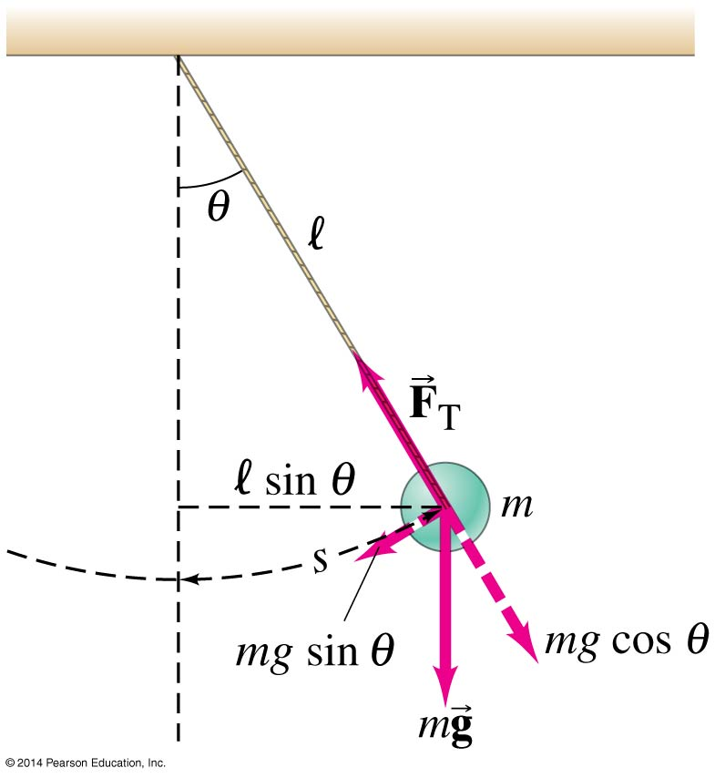
The Simple Pendulum
A simple pendulum consists of a mass at
the end of a lightweight cord. We assume
that the cord does not stretch, and that its
mass is negligible.
In order to be in SHM, the restoring force
must be proportional to the negative of the
displacement. Here we have F = ‑mg sin θ
which is proportional to sin θ and not to θ itself.
However, if the angle is small, sin θ ≈ θ.

Slide 20
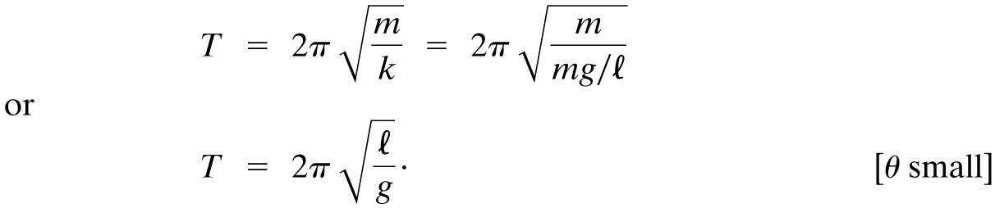
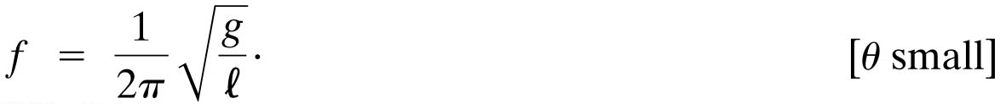
The Simple Pendulum
Therefore, for small angles, the force is approximately proportional to the angular displacement.
The period and frequency are:

Slide 21
Example
The kinetic energy of a 0.125-kg mass on a spring is 4.0J and its amplitude is 2.0 cm.
Determine the maximum velocity of the mass.
Determine the spring constant k of the spring.
Determine acceleration of the mass when displacement is 10.0 mm.
Solution
a) When the kinetic energy is maximum, the velocity is also maximum. Thus 4.0 = (1/ 2)mv_{MAX}² so that
4.0 = (1/ 2)(.125)v_{MAX}² → v_{MAX} = 8.0 ms⁻¹.

Slide 22
Solution continues
b) E_{P} = (1/2)kx².
Note that E_{K} = 0 at x = x_{MAX} = 2.0 cm. Thus
E_{K} + E_{P} = E_{T} = CONST → E_{T} = 0 + (1/ 2)kx_{MAX}² so that
4.0 = (1/ 2)k 0.020² → k = 20000 Nm⁻¹.
c) From Hooke’s law, F = -kx we get
F = -20000(0.01) = -200 N.
•From F = ma we get -200 = 0.125a → a = -1600 ms⁻².

Slide 23

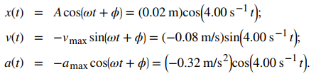
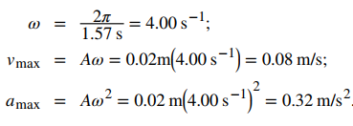
Example
A 2.0-kg block is placed on a frictionless surface. A spring with a force constant of k = 32.0 N/m is attached to the block, and the opposite end of the spring is attached to the wall. The spring can be compressed or extended. The equilibrium position is marked as x = 0.0 m. Work is done on the block, pulling it out to x = + 0.02m. The block is released from rest and oscillates between x = + 0.02m and x = -0.02 m. The period of the motion is 1.57 s. Determine the equations of motion.
Solution The equations of motion are:

Slide 24




Example
What is the acceleration due to gravity in a region where a simple pendulum having a length 75.000 cm has a period of 1.7357 s? Assume the angle of deflection is very small. Solution

Slide 25
Exercises
Ex. 15 no. 33, 36, 42 and 60.
Ex. No. 23, 33, 36, 49,53 and 81.
Attention
Submit your assignments through the Class representative. Marks will be deducted for late submission.

Slide 26
References
University Physics Volume 1
L. Samuel @ 2016 OpenStax College
Physics: Principles with Applications
C. Giancoli @ 2014, Pearson, ISBN- 13:9780321625922
Physics at New Jersey Science & Technology University
Dale Gary @ NJIT Physics Department

